Slide 1
CAPSTONE PROJECT ON EXCEL Submission to Board Infinity
PROJECT: E-BUSINESS SALES TRANSACTION.
by
Vaishnavi pravin waghmare
L-Path: Data Science

Slide 2
PROBLEM STATEMENT
What is Sales Trend over Month?
Which are the Top 10 most purchased products?
What is the average number of products in each transaction?
Which are the top 5 revenue-generating products?
What is Revenue from the top 5 countries?
What is the Top 20 products and quantity?
What is Revenue and transaction?
What is Country-wise sales and revenue?
What is Month-wise revenue from countries?

Slide 3
ABOUT DATA
This is a dataset of UK-based B2C e-commerce sales transactions for one year.
This London-based shop has been selling gifts and homewares for adults and children through the website since 2007.
Their customers come from all over the world and usually make direct purchases for themselves. There are also small businesses that buy in bulk and sell to other customers through retail outlet channels.
The following is the description of each column.
Transaction NO: a six-digit unique number that defines each transaction.
Date : the date when each transaction was generated.
Product No : a five or six-digit unique character used to identify a specific product.
Price : the price of each product per unit in pound sterling (£).
Quantity : the quantity of each product per transaction. Negative values related to cancelled transactions.
Customer No: a five-digit unique number that defines each customer.
Country : name of the country where the customer resides.

Slide 4
This chart is about the number of sales over the months in a year.
Where trendline shows the sales are linear in the year.

Slide 5
This chart is about the top 10 popularly purchase products.
Where popcorn holder is one of the most purchase products.

Slide 6
This chart is about the average number of products in each transaction.
Where the maximum number of products is 1111 in transaction id 573585.

Slide 7
This chart is about the top 5 products due to which maximum revenue is generated.
Where ‘assorted color bird ornament’ is highest purchasing rate is 24% .

Slide 8
This chart tells about the countries from which maximum revenue is generated.
The uk purchases maximum products so it provides maximum revenue to the business.

Slide 9
This chart is about the top 20 products and the count of their purchases.
Popcorn holder is highest purchases with 56450 quantity.

Slide 10
This chart is about revenue per customer and the number of transactions by customers.
We see that revenue and transaction are not that related, as for some customers have a maximum transaction in spit generated revenue is low.

Slide 11
This chart is about country-wise sales and revenue.
the trendline says is that as sales increase revenue also increases.

Slide 12
Revenue from the top 3 months from different countries.
For UK country in the month of august maximum purchase is done.

Slide 13
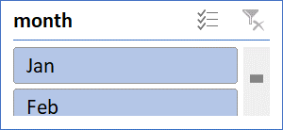
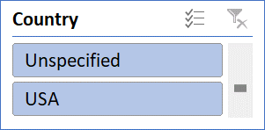
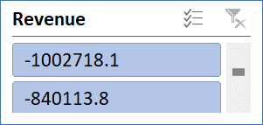
DASHBOARD-1 FOR E-BUSINESS SALES TRANSACTION

Slide 14
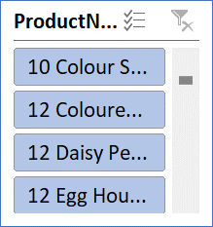
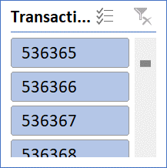
DASHBOARD -2 FOR TOP CATEGARIES

Slide 15
Summary
Trend of sales over a month shows that sales of the product are linner in the whole year. Which is good for business.
Where 10 products are mostly purchased, so their supply should increase.
we get that an average of 727 products are bought during each transaction. The trend of buying products is increasing so need to increase production.
There are only 5 countries which purchase maximum products. To increase countries participation in business should provide them offers.
In country-wise sales and revenue UK itself generate maximum revenue.
In short businesses should focus on supply and production and they should provide offers and sales to counties to increase their participation.

Slide 16
References and links
https://drive.google.com/file/d/1hbxFHrpNortL-DfRRw4uVlFsYYG3ney6/view?usp=sharing

